Slide 1
Communicating Legal Precedent by Estimating Preparation Hours Needed for Criminal Cases Estimating Preparation Hours based on Expected Trial Days
Faculty of Information, University of Toronto
INF1344: Introduction to Statistics for Data Science
Professor Abbas Keramati
Group 11:
Hamid Parsazadeh (997034472)
Isabel Bowman (1003469640)
Kuo-Lun Chang (1007618641)
Bethlehem Zebib (1008516660)
Ragave Vicknarajah (1003959610)
December 12, 2021

Slide 2
Introduction
Background
Research Question and Objectives

Slide 3
Methodology
Using regression Modeling to predict Prep. Hours based on Est. Court Days
Data Collection
Models Comparison
Model Selection
Data Preparation
11 years Historical Data
Initial Hypotheses & Distribution review
Fitting all the potential models
Selecting the best fitted Model

Slide 4
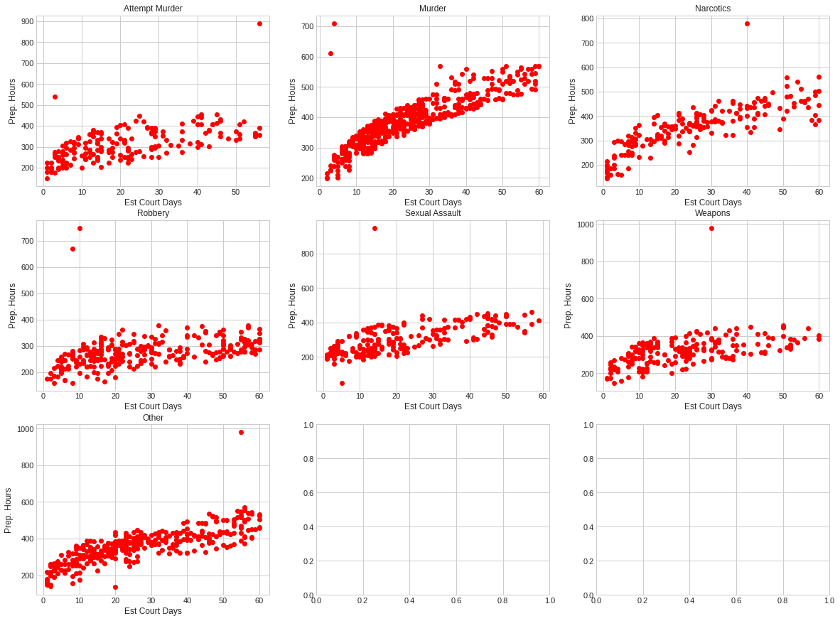
Initial Data visualization
Observation:
Strong correlation
Outliers
Gently increasing pattern linear or curved

Slide 5
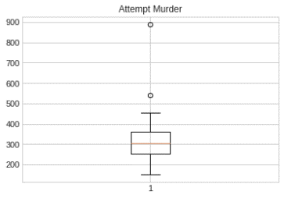
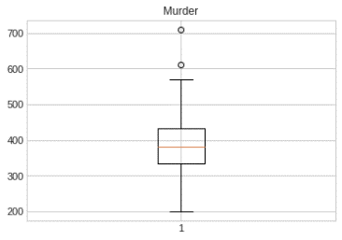
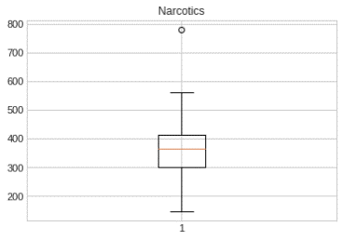
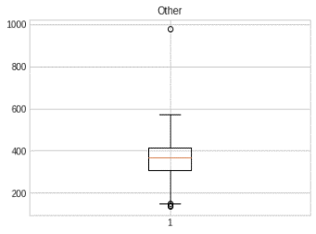
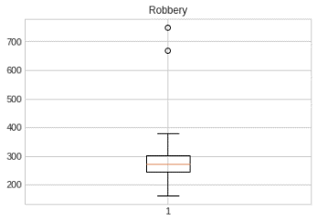
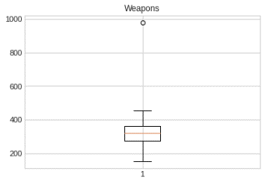
Outliers Identification
Using Boxplot to identify outliers
Implemented rule: 1.5 times of the interquartile range defines the boundary of the data.
In consultation with the stakehouldrs the outliers are removed since they are very exceptional cases that will not fit for any modeling

Slide 6
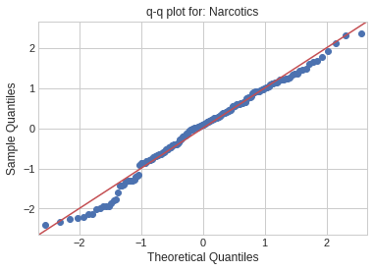
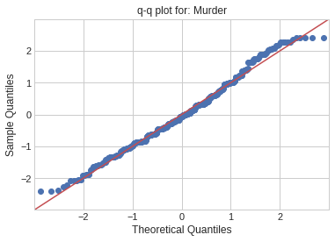
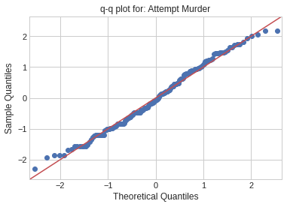
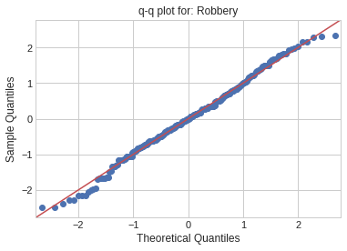
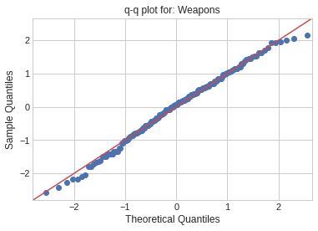
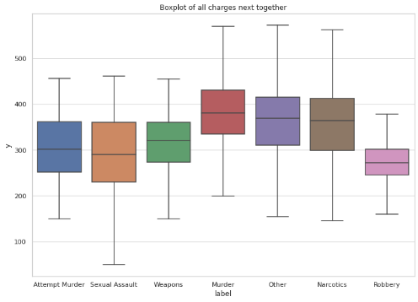
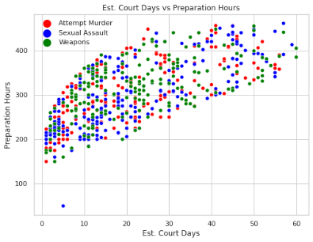
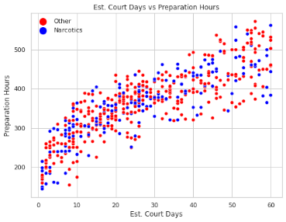
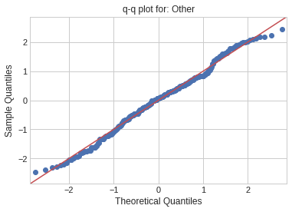
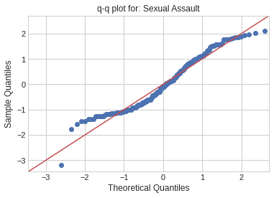
Populations’ Distribution
We use Q-Q plots and One Sample K-S statistic to verify the Normal Distribution of each charge’s population.
We use T-test and Leneve test for comparing charge distributions two by two.
We summarize the charges in four groups:
Group 1: Attempt Murder, Sexual Assault & Weapons
Group 2: Murder
Group 3: Narcotics and Other
Group 4: Robbery

Slide 7
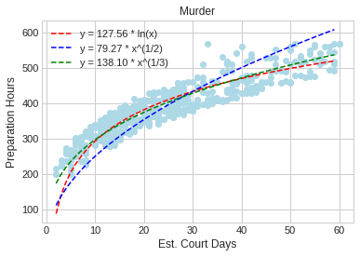
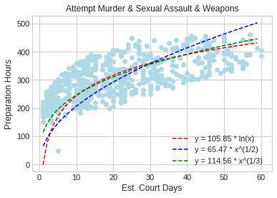
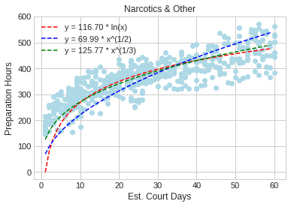
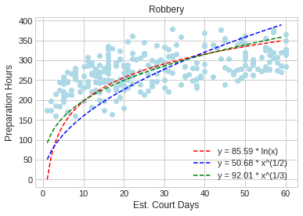
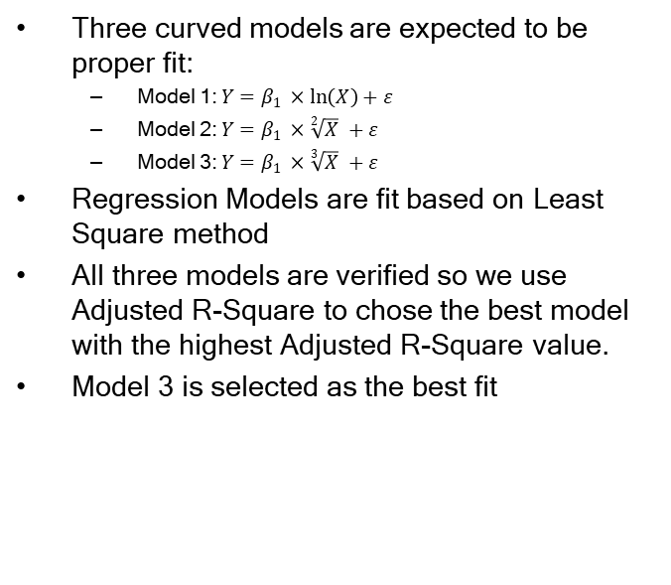
Comparing different Models
Three curved models are expected to be proper fit:
Model 1: $Y=β_{1} ×\ln\left(X\right)+ε$
Model 2: $Y=β_{1} ×\sqrt[2]{X} +ε$
Model 3: $Y=β_{1} ×\sqrt[3]{X} +ε$
Regression Models are fit based on Least Square method
All three models are verified so we use Adjusted R-Square to chose the best model with the highest Adjusted R-Square value.
Model 3 is selected as the best fit

Slide 8
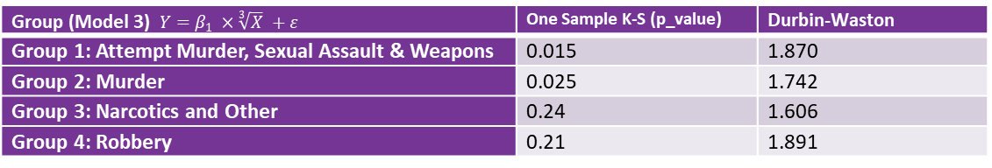
Testing Key Assumptions
Group (Model 3) $Y=β_{1} ×\sqrt[3]{X} +ε$ | One Sample K-S (p_value) | Durbin-Waston
Group 1: Attempt Murder, Sexual Assault & Weapons | 0.015 | 1.870
Group 2: Murder | 0.025 | 1.742
Group 3: Narcotics and Other | 0.24 | 1.606
Group 4: Robbery | 0.21 | 1.891
Since the p_value of One Sample K-S tests are not less than α = 0.01 we cannot reject the residuals normal distribution
Since the Durbin-Wastons are within the range of 1.5 to 2.5 we conclude that residuals are not autocorrelated

Slide 9
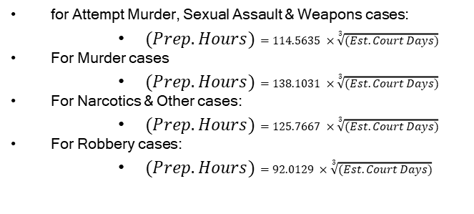
Conclusion
With 99% confidence level to predict the number of required preparation hours based on the estimated number of court days between 1 to 60, the business management team can use the following models for each criminal charge:
for Attempt Murder, Sexual Assault & Weapons cases:
$(Prep. Hours)=114.5635 ×\sqrt[3]{(Est. Court Days)}$
For Murder cases
$(Prep. Hours)=138.1031 ×\sqrt[3]{(Est. Court Days)}$
For Narcotics & Other cases:
$(Prep. Hours)=125.7667 ×\sqrt[3]{(Est. Court Days)}$
For Robbery cases:
$(Prep. Hours)=92.0129 ×\sqrt[3]{(Est. Court Days)}$

